Slide 1

Weekly meeting
Yeh Shun-Liang
International College of Semiconductor Technology
National Yang Ming Chiao Tung University

Slide 2
Recent Progress
Analyze the ideal bandwidth and analyze the bandwidth lost
Give clear definition of Write Updated partial refresh and its analysis

Slide 3
Configuration
Simulation Configuration
DRAM Model | Proposed 3D-DRAM Model
Number of Banks | 64
Ideal Bandwidth | 2TB/s
Ideal Bandwidth per Core | 128GB/s
Name of Trace | Single Core LLM Workload Trace
Number of Traces | 193881265
Temperatures | Less than 85°C, 85~95°C & above 95°C

Slide 4
Bandwidth Breakdown

Slide 5
Energy breakdown of LLM workload

Slide 6
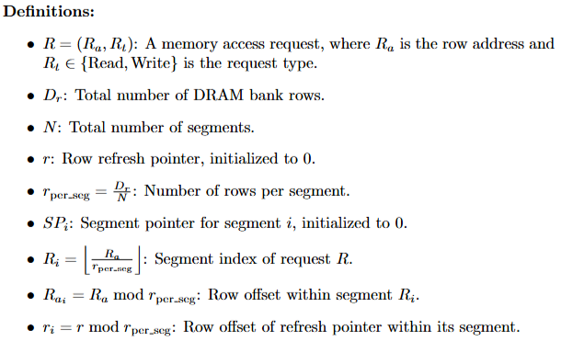
Write Updated Partial Refresh(WUPR)

Slide 7
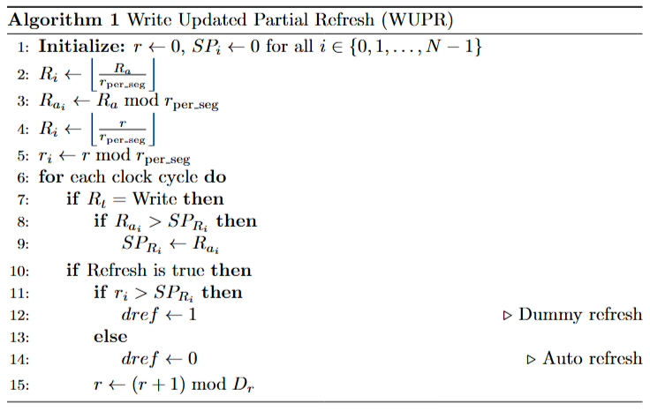
Write Updated Partial Refresh(WUPR)

Slide 8
WUPR with 4 Segments(N=4)
SP₀
WUPR
N₀
Pointer Update Logic
Segment Pointers
Used Space
Request
R
Ra
SP₁
r
Unused Space
Row Tracker
N₁
refresh
Refresh
SP₂
r
Select & Compare
SP₀
dref
dref
SP₁
N₂
SP₂
SP₃
SP₃
N₃
DRAM Row Space

Slide 9
WUPR Architecture
3D DRAM Bank
Memory Controller
Mode Register
DRAM rows
WUPR
Command Bus
Row Decoder
1
Row buffer
2
Refresh
Dummy Refresh/AR
Refresh
Management
Refresh
Counter
Update
2
Bhati, I., Chishti, Z., Lu, S.-L., & Jacob, B. (2015). Flexible auto-refresh: Enabling scalable and energy-efficient DRAM refresh reductions. In Proceedings of the 42nd Annual International Symposium on Computer Architecture

Slide 10
WUPR Optimal number of Segments
Find the optimal number of segments that best describe the LLM trace pattern, 16 Segments is enough

Slide 11
WUPR Area Cost for number of segments
0.97% area of DRAM Controller

Slide 12
WUPR Analysis Bandwidth

Slide 13
WUPR Analysis Energy Comparison

Slide 14
WUPR Analysis Refresh Counts

Slide 15
Reference
[1] I. Bhati, Z. Chishti, S.-L. Lu, and B. L. Jacob, "Flexible Auto-Refresh: Enabling Scalable and Energy-Efficient DRAM Refresh Reductions," in Proceedings of the 42nd Annual International Symposium on Computer Architecture (ISCA), Portland, OR, USA, June 2015

